Slide 1
Statistics
Summarize, Analyze and Predict Data

Slide 2
Statistical learning
Statistical learning refers to a vast set of tools for understanding data.
Descriptive Statistics: uses the data to provide descriptions of the population, either through numerical calculations or graphs or tables
Inferential Statistics: makes inferences and predictions about a population based on a sample of data taken from the population in question

Slide 3
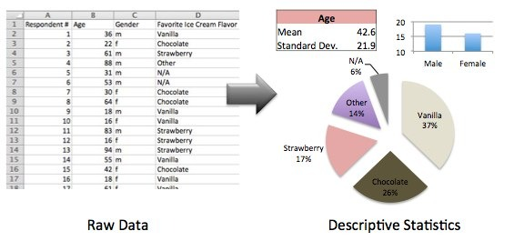
Example Descriptive Statistics
a survey to 35 people about their favorite ice cream flavors.

Slide 4
Example Inferential Statistics
Let’s say that 37% of people in our sample said that vanilla is their favorite flavor.
Can we safely extrapolate that 37% of all people in the world also think that vanilla is the best?
Is that the true value of the world? Well, we can’t say with 100% confidence,
but–using inferential statistical techniques such as the “confidence interval”–I can provide a range of people that prefer vanilla with some level of confidence.

Slide 5
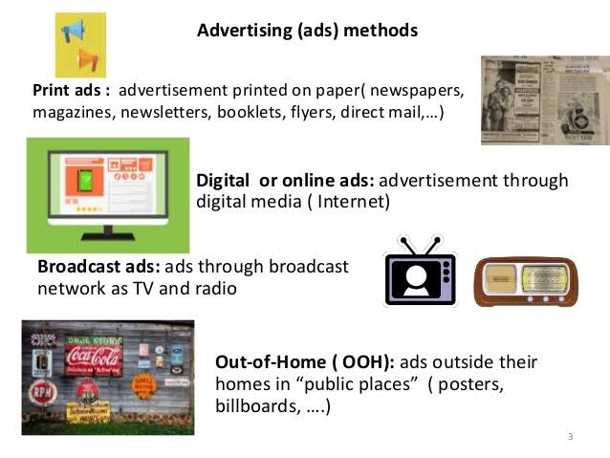
Example Inferential Statistics
Sales (in thousands of units) for a particular product as a function of advertising budgets (in thousands of dollars) for TV, radio, and newspaper media. Suppose that in our role as statistical consultants we are asked to suggest.
1). We want to find a function that given input budgets for TV, radio and newspaper predicts the output sales.
(2). Which media contribute to sales?

Slide 6
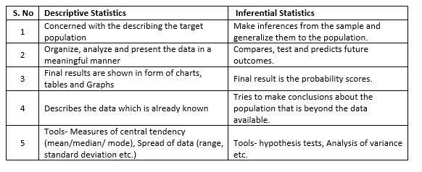
Types of Statistics

Slide 7
Probability Motivation-Inferential Statistics
Uncertainty arises through:
• Noisy measurements
• Finite size of data sets
• Ambiguity: The word bank can mean (1) a financial institution, (2) the side of a river, or (3) tilting an airplane. Which meaning was intended, based on the words that appear nearby?
• Limited Model Complexity

Slide 8
Probability in Machine Learning
Classification models must predict a probability of class membership.
Algorithms are designed using probability (e.g. Naive Bayes).
Learning algorithms will make decisions using probability (e.g. information gain).
Sub-fields of study are built on probability (e.g. Bayesian networks).
Algorithms are trained under probability frameworks (e.g. maximum likelihood).
Models are fit using probabilistic loss functions (e.g. log loss and cross entropy).
Model hyperparameters are configured with probability (e.g. Bayesian optimization).
Probabilistic measures are used to evaluate model skill (e.g. brier score, ROC).

Slide 9
Probability Theory
Probability theory provides a consistent framework for the quantification and manipulation of uncertainty
Allows us to make optimal predictions given all the information available to us, even though that information may be incomplete or ambiguous

Slide 10
Probability
Probabilistic statements subsume different effects due to:
convenience: declaring all conditions, exceptions, assumptions would be too complicated.
Example: “I will be in lecture if I go to bed early enough the day before and I do not become ill and my car does not have a breakdown and ...”
or simply: I will be in lecture with probability of 0.87

Slide 11
Probability
lack of information: relevant information is missing for a precise statement.
Example: weather forecasting
intrinsic randomness: non-deterministic processes.
Example: appearance of photons in a physical process
intuitively, probabilities give the expected relative frequency of an event

Slide 12
Population Vs Sample
A population data set contains all members of a specified group (the entire list of possible data values). Example: The population may be "ALL people living in the India.“
A sample data set contains a part, or a subset, of a population. The size of a sample is always less than the size of the population from which it is taken. Example: The sample may be "SOME people living in the India."

Slide 13
Random Experiment and Random Variable
Random variables describe the outcome of a random experiment in terms of a (real) number
Random experiment is a experiment that can (in principle) be repeated several times under the same conditions

Slide 14
Sample Space
The sample space Ω is the set of possible outcomes of an experiment.
Points ω in Ω are called sample outcomes,realizations, or elements.
Subsets of Ω are called Events.
Example. If we toss a coin twice then Ω = {HH,HT, TH, TT}. The event that the first toss is heads is A = {HH,HT}

Slide 15
Probability Calculation
P(Probability of an Event) =
Number of Favorable Outcomes Total Number of Possible Outcomes

Slide 16
Two dice are rolled once. Calculate the probability that the sum of the numbers on the two dice is 5.
Possible outcomes (Sample Space) = {(1, 1), (1, 2),...............,(1, 6), (2, 1), (2, 2),................,(2, 6), (3, 1), (3, 2),...........,(3, 6), .............,(4, 1), (4, 2),..........,(4, 6), (5, 1), (5,2),...............,(5, 6), (6, 1), (6, 2),......................,(6, 6)} Total possible outcomes = 36 Number of outcomes of the experiment that are favorable to the event that a sum of two events is 6 => Favorable outcomes are: (1, 5), (2, 4), (3, 3), (4, 2) and (5, 1) Number of favorable outcomes = 5
probability formula = Number of favorable outcomes/Total number of possible outcomes = 5/36 The probability of a sum of 6 is 5/36.

Slide 17
Mutually Exclusive
Two events are mutually exclusive when two events cannot happen at the same time.
The probability that one of the mutually exclusive events occur is the sum of their individual probabilities.
P(X or Y)= P(X) + P(Y)

Slide 18
Disjoint Events
We say that events A1 and A2 are disjoint (mutually exclusive) never occur at the same time
if Ai ∩ Aj = {}
• Example: first flip being heads and first flip being tails

Slide 19
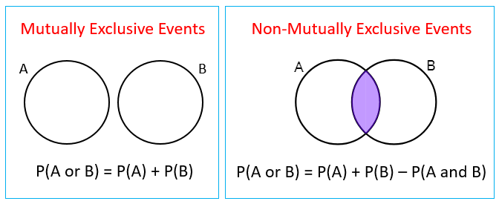
Mutually Exclusive VS Non-Mutually Exclusive

Slide 20
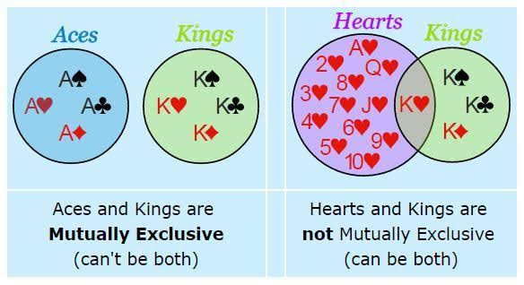
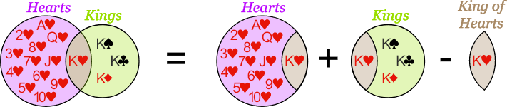
Mutually Exclusive VS Non-Mutually Exclusive

Slide 21
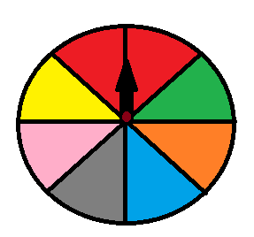
Mutually Exclusive
What is the probability that the wheel stops at red or pink?
P(red or pink)=P(red)+P(pink)
P(red)=28=14
P(pink)=18
P(red or pink)=18+28=38

Slide 22
Inclusive Events
Inclusive events are events that can happen at the same time.
To find the probability of an inclusive event we first add the probabilities of the individual events and then subtract the probability of the two events happening at the same time.
P(X or Y)= P(X) + P(Y) − P(X and Y)

Slide 23

Inclusive Events
What is the probability of drawing a black card or a ten in a deck of cards?
There are 4 tens in a deck of cards P(10) = 4/52
There are 26 black cards P(black) = 26/52
There are 2 black tens P(black and 10) = 2/52
P(black or ten) = 4/52 + 26/52 − 2/52 =30/52−2/52
= 28/52 = 713

Slide 24
Independent Event
Independent Events A and B are independent if knowing whether A occurred gives no information about whether B occurred. (not effected by previous or occurrence of event)
More formally, A and B (which have nonzero probability) are independent if and only if one of the following equivalent statements holds:
P(A | B) = P(A)P(B)
P(A|B) = P(A)
P(B|A) = P(B)

Slide 25
Independent Event
Example: You toss a coin and it comes up "Heads" three times ... what is the chance that the next toss will also be a "Head"?
The chance is simply ½ (or 0.5) just like ANY toss of the coin.
What it did in the past will not affect the current toss!

Slide 26
Independent Event
Example: your boss (to be fair) randomly assigns everyone an extra 2 hours work on weekend evenings between 4 and midnight. What are the chances you get Saturday between 4 and 6?
Day: there are two days on the weekend, so P(Saturday) = 0.5
Time: you want the 2 hours of "4 to 6", out of the 8 hours of 4 to midnight):
P("4 to 6") = 2/8 = 0.25 And
P(Saturday and "4 to 6") = P(Saturday) × P("4 to 6")
= 0.5 × 0.25 = 0.125
Or a 12.5% Chance

Slide 27
Example: the chance of a flight being delayed is 0.2 (=20%), what are the chances of no delays on a round trip
The chance of a flight not having a delay is 1 − 0.2 = 0.8, so these are all the possible outcomes:
0.8 × 0.8= 0.64 chance of no delays
0.2 × 0.8 = 0.16 chance of 1st flight delayed
0.8 × 0.2 = 0.16 chance of return flight delayed
0.2 × 0.2 = 0.04 chance of both flights delayed
(Adding all 0.64 + 0.16 + 0.16 + 0.04= 1.0 for checking)
0.64, or a 64% chance of no delays

Slide 28
Dependent Event
Two events are dependent when the outcome of the first event influences the outcome of the second event.
The probability of two dependent events is the product of the probability of X and the probability of Y AFTER X occurs.
P(X and Y)=P(X)⋅P(Y after X)

Slide 29
Dependent Example
What is the probability for you to choose two red cards in a deck of cards?
A deck of cards has 26 black and 26 red cards. The probability of choosing a red card randomly is:
P(red)=26/52=12
The probability of choosing a second red card from the deck is now: P(red)=25/51
The probability: P(2red)=12⋅25/51=25/102

Slide 30
Joint Probability
the likelihood of two events occurring together and at the same point in time P (X⋂Y)
where: X,Y = Two different events that intersect
P(X and Y), P(X,Y)=The joint probability of X and Y
The joint probability of picking up a card that is both red and 6
P(X∩ Y)= P(X) × P(Y) = 4 / 52 × 26 / 52 = 1 / 26
​

Slide 31
Joint Probability
For example, the probability of drawing a red card from a deck of cards is 1/2 = 0.5. This means that there is an equal chance of drawing a red and drawing a black(both are disjoint); since there are 52 cards in a deck, of which 26 are red and 26 are black, there is a 50-50 probability of drawing a red card versus a black card.
from a deck of 52 cards, the joint probability of picking up a card that is both red and 6 is P(6 ∩ red) = 2/52 = 1/26, since a deck of cards has two red sixes—the six of hearts and the six of diamonds. You can also use the following formula to calculate the joint probability:
P(6 ∩ red) = P(6) × P(red) = 4 / 52 × 26 / 52= 1 / 26

Slide 32
Conditional Probability
Probability that one event will happen given that another action or event happens. The conditional probability formula is as follows:
P(X, given Y) P(X | Y) = P(X ∩ Y) / P(Y)
from a deck of cards, the probability that you get a six, given that you drew a red card is P(6│red) = 2/26 = 1/13, since there are two sixes out of 26 red cards.

Slide 33
Conditional Probability
conditionals:
Example: if someone is taking a shower, he gets wet (by causality)
P(“wet”|“taking a shower”) = 1
while:
P(“taking a shower”|“wet”) = 0.4
because a person also gets wet if it is raining

Slide 34
Conditional Probability
Can also be used to calculate joint probability
P(X∩Y)=P(X∣Y)×P(Y)
P(6∩red)=P(6∣red)×P(red)=1/13×26/52=1/13×1/2=1/26​

Slide 35
Bayes Theorem
P(A | B) = P(B |A) P(A) / P(B)
P(A|B,C) = P(B|A,C)P(A|C)/ P(B|C)
P(A)= The probability of A occurring
P(B)= The probability of B occurring
P(A | B) =The probability of A given B
P(B |A) =The probability of B given A
is known as Bayes rule.

Slide 36
Bayes Theorem
Bayes' theorem can be used to determine the accuracy of medical test results by taking into consideration how likely any given person is to have a disease and the general accuracy of the test.
Bayes' theorem relies on incorporating prior probability distributions in order to generate posterior probabilities.

Slide 37
Prior and Posterior Probability
Prior probability, in Bayesian statistical inference, is the probability of an event before new data is collected.
Posterior probability is the revised probability of an event occurring after taking into consideration new information. Posterior probability is calculated by updating the prior probability by using Bayes' theorem.
In statistical terms, the posterior probability is the probability of event A occurring given that event B has occurred

Slide 38
Often this is useful in diagnosis situations, since P(observation|reason)
might be easily determined.
if patient has meningitis, then very often a stiff neck is observed
P(S|M) = 0.8 (can be easily determined by counting)
observation: ’I have a stiff neck! Do I have meningitis?’ (is it reasonable to be afraid?)
P(M|S) =?
we need to now: P(M) = 0.0001 (one of 10000 people has meningitis)
and P(S) = 0.1 (one out of 10 people has a stiff neck).
then:
P(M|S) = P(S|M)P(M)/ P(S) = 0.8 × 0.0001/ 0.1 = 0.0008
Keep cool. Not very likely

Slide 39
Random Variable
How do we link sample spaces and events to data?
• A random variable is a mapping that assigns a real number X(ω) to each outcome ω
• Example: Flip a coin ten times.
Let X(ω) be the number of heads in the sequence ω.
If ω = HHTHHTHHTT, then X(ω) = 6.

Slide 40
Discrete vs Continuous Random Variables
Discrete: can only take a countable number of values
• Example: number of heads
Continuous: can take infinitely many values (real numbers)
• Example: time taken to accomplish task

Slide 41
Probability Distribution of Discrete Random Variable
Probability distributions for discrete random variables can be represented in tables:
Example: random variable X (rolling a dice):
X 1 2 3 4 5 6
P(X) 1/6 1/6 1/6 1/6 1/6 1/6
probability distributions for continuous random variables need another form of representation
gives values for all possible assignments

Slide 42
Continues Random Variable
problem: infinitely many outcomes
considering intervals instead of single real numbers: P (a < X ≤ b )

Slide 43
Continues Random Variable
Cumulative Distribution Functions (cdf):
A function F : R → [0, 1] is called cumulative distribution function of a random variable X if for all c ∈ R hold:
P ( X ≤ c) = F ( c )
Knowing F, we can calculate P (a < X ≤ b ) for all intervals from a to b
F is monotonically increasing, lim x→−∞ F ( x) = 0, lim x→∞ F ( x) = 1
if exists, the derivative of F is called a probability density function (pdf). It yields large values in the areas of large probability and small values in the areas with small probability. But: the value of a pdf cannot be interpreted as a probability!

Slide 44
Other type of Data?
1
100
1.1
5.4
‘red’
‘cat’
‘first’
Discrete
Continues
Categorical
Numerical
Categorical

Slide 45
Level of Measurement
Nominal
Categorical
Ordinal
Interval
Numerical
Ratio

Slide 46
Nominal
Nominal sounds like name
dichotomous or categorical
Lowest level of measurement
Discrete categories
No natural order
May be referred to qualitative or categorical data

Slide 47
Nominal
Gender
0-Female
1-Male
Group Membership
1- Experimental
2-Placebo
3-Routine
Color, Religion, Type of car

Slide 48
ORDINAL
Notes :
Ordered Categories
Relative Rankings
Unknown Distance Between Ranking
Zero is arbitrary
Examples:
Likert Scales
1=strongly agree, 2=agree
Socioeconomic status
1=Low, 2=Middle, 3=High
Size
1=Small, 2=Medium, 3=Large
Size, ranking of favourite sports,
Class rankings, Wellness rankings

Slide 49
ORDINAL
Customer Satisfaction
Are you “very satisfied,”
”Satisfied,”
“neither satisfied nor
dissatisfied,”
“dissatisfied,” or
“Very Satisfied.”
Movie Ratings

Slide 50
ORDINAL
Notes :
Order Matters
But not the Difference between values
Unknown distance between rankings
Relative Rankings
Likert scales
Socioeconomic status
Pain intensity
Non- Numeric
Possible Measures:
All Nominal level tests
Median
Percentile
Semi-quartile range
Rank order Coefficients
of correlation

Slide 51
Interval
Ordered Categories
Equal Distance between values
Can measure distance
An accepted unit of measurement
Zero is arbitrary
All ordinal Tests
Mean
Standard deviation
Addition and subtraction
Cannot multiply or divide
Temperature in Degree Celsius, Fahrenheit

Slide 52
52
RATIO
Notes :
Most Precise
Ordered
Exact Values
Equal Intervals
Natural Zero
When the Variable Equals O
it Means there is none of
that variable
Not arbitrary
Possible Measures:
Weight
Height
Pulse
Blood Pressure
Time
Temperature Degrees Kelvin

Slide 53
53
RATIO
Notes :
Precise, Ordered, Exact
Equal Intervals
Natural Zero
Weight
Time
Degrees Kelvin
Possible Measures:
All Operations are possible
Descriptive and inferential
statistics
Can Make comparisons
An 8 Kg baby is twice as
Heavy as a 4 Kg baby
Can add, Subtract, multiply,
Divide (ratios)

Slide 54
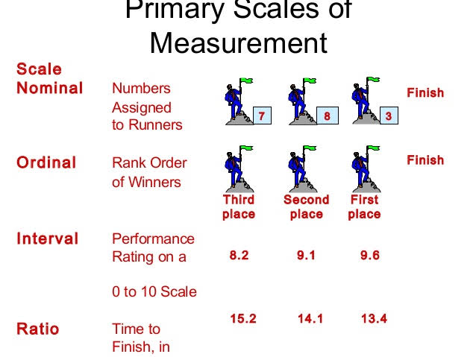

Slide 55
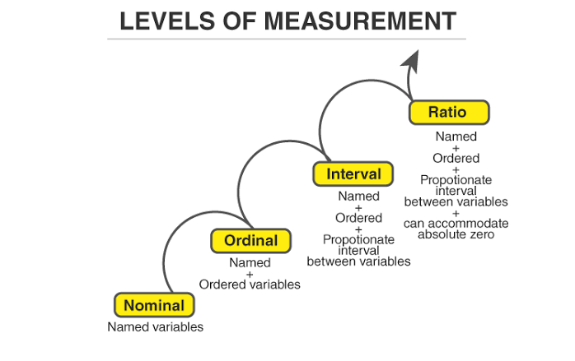

Slide 56
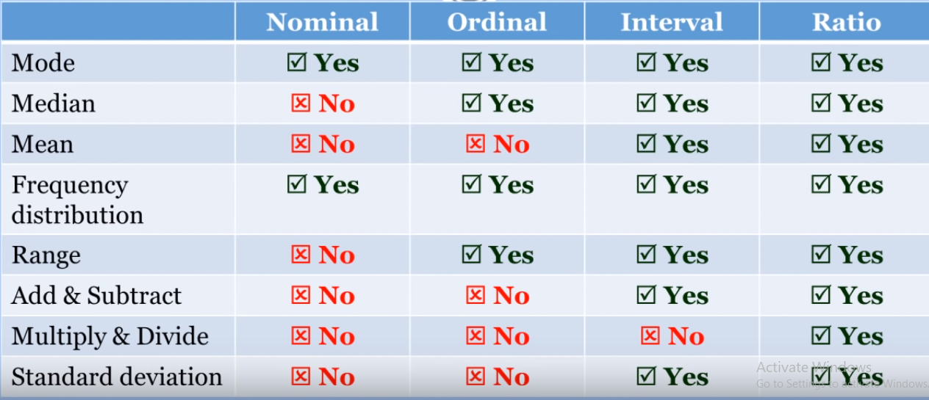
SOME STATISTICAL TESTS

Slide 57
Quiz1
If the grading of diabetes is classified as mild, moderate and severe the scale of measurement used is :
A. Interval B. Nominal C. Ordinal D. Ratio

Slide 58
Quiz 1
C. Ordinal
Here data can be arranged in a useful order. But there is no info regarding the size of each interval.

Slide 59
Quiz 2
How do you stock items at present?
[ ] By product category [ ] At a centralized store [ ] Department wise [ ] Single warehouse

Slide 60
Quiz 2
Nominal

Slide 61
Quiz 3
Which of the following statistics is not permissible with nominally scaled data?
chi-square
median
range
both b and c are not permissible

Slide 62
Quiz 3
D. Both b and c are not permissible

Slide 63
Quiz 4
Rank the following attributes (1 - 5), on their importance in a microwave oven.
Company Name
Functions
Price
Comfort
Design

Slide 64
Quiz 4
Ordinal

Slide 65
Quiz 5
In business research, attitudinal data obtained from rating scales are often treated as _____ data.
nominal
ordinal
interval
ratio

Slide 66
Quiz 5
C. Interval

Slide 67
Quiz 6
In business, sales, cost, market share, and number of customers are variables measured on a _____ scale.
nominal
ordinal
interval
ratio

Slide 68
Quiz 6
D. Ratio

Slide 69
Summary Measures
Summary Measures
Central Tendency
Quartile
Variation
Mean
Mode
Median
Range
Coefficient of Variation
Variance
Midrange
Standard Deviation
Midhinge

Slide 70
Measures of Central Tendency
Central Tendency
Mean
Median
Mode
Midrange
Midhinge

Slide 71
The Mean (Arithmetic Average)
It is the Arithmetic Average of data values:
The Most Common Measure of Central Tendency
Affected by Extreme Values (Outliers)
Sample Mean
0 1 2 3 4 5 6 7 8 9 10
0 1 2 3 4 5 6 7 8 9 10 12 14
Mean = 5
Mean = 6

Slide 72
The Median
Important Measure of Central Tendency
In an ordered array, the median is the
“middle” number.
If n is odd, the median is the middle number.
If n is even, the median is the average of the 2
middle numbers.
Not Affected by Extreme Values
0 1 2 3 4 5 6 7 8 9 10
0 1 2 3 4 5 6 7 8 9 10 12 14
Median = 5
Median = 5

Slide 73
The Mode
A Measure of Central Tendency
Value that Occurs Most Often
Not Affected by Extreme Values
There May Not be a Mode
There May be Several Modes
Used for Either Numerical or Categorical Data
0 1 2 3 4 5 6
0 1 2 3 4 5 6 7 8 9 10 11 12 13 14
No Mode
Mode = 9

Slide 74
Midrange
A Measure of Central Tendency
Average of Smallest and Largest
Observation:
Affected by Extreme Value
Midrange
0 1 2 3 4 5 6 7 8 9 10
0 1 2 3 4 5 6 7 8 9 10
Midrange = 5
Midrange = 5

Slide 75
Quartiles
Not a Measure of Central Tendency
Split Ordered Data into 4 Quarters
Position of i-th Quartile: position of point
25%
25%
25%
25%
Q₁
Q₂
Q₃
Q
i(n+1)
=
i
4
Data in Ordered Array: 11 12 13 16 16 17 18 21 22
=
1•(9 + 1)
Position of Q₁
= 2.50
Q₁
=12.5
4

Slide 76
Midhinge
A Measure of Central Tendency
The Middle point of 1st and 3rd Quarters
Not Affected by Extreme Values
Midhinge =
Data in Ordered Array: 11 12 13 16 16 17 18 21 22
Midhinge =

Slide 77
The Range
Measure of Variation
Difference Between Largest & Smallest
Observations:
Range =
Ignores How Data Are Distributed:
Range = 12 - 7 = 5
Range = 12 - 7 = 5
7 8 9 10 11 12
7 8 9 10 11 12
Notes:
Range increases with sample size

Slide 78
Interquartile Range
Measure of Variation
Also Known as Midspread:
Spread in the Middle 50%
Difference Between Third & First
Quartiles: Interquartile Range =
Not Affected by Extreme Values
Data in Ordered Array: 11 12 13 16 16 17 17 18 21
= 17.5 - 12.5 = 5

Slide 79
Variance
Important Measure of Variation
Shows Variation/Deviation About the Mean:
For the Population:
For the Sample:
For the Population: use N in the denominator.
For the Sample : use n - 1 in the denominator.

Slide 80
Comparing Standard Deviations
Data : 10 12 14 15 17 18 18 24
N= 8 Mean =16
s =
= 4.2426
= 3.9686
Value for the Standard Deviation is larger for data considered as a Sample.

Slide 81
Comparing Standard Deviations
Data A
Mean = 15.5
s = 3.338
11 12 13 14 15 16 17 18 19 20 21
Data B
Mean = 15.5
s = .9258
11 12 13 14 15 16 17 18 19 20 21
Data C
Mean = 15.5
s = 4.57
11 12 13 14 15 16 17 18 19 20 21

Slide 82
Coefficient of Variation
Measure of Relative Variation
Always a %
Shows Variation Relative to Mean
Used to Compare 2 or More Groups
Formula ( for Sample):

Slide 83
Comparing Coefficient of Variation
Stock A: Average Price last year = $50
Standard Deviation = $5
Stock B: Average Price last year = $100
Standard Deviation = $5
Coefficient of Variation:
Stock A: CV = 10%
Stock B: CV = 5%

Slide 84
Shape
Describes How Data Are Distributed
Measures of Shape:
Symmetric or skewed
Left-Skewed
Symmetric
Right-Skewed
Mean
Median
Mode
Mean
=
Median
=
Mode
Mode
Median
Mean

Slide 85
Box-and-Whisker Plot
Graphical Display of Data Using 5-Number Summary
X
Q
Median
Q
X
smallest
1
3
largest
4
6
8
10
12

Slide 86
Distribution Shape & Box-and-Whisker Plots
Left-Skewed
Symmetric
Right-Skewed
Q
Median
Q
Q
Median
Q
Q
Median
Q
1
3
1
3
1
3

Slide 87
Statistics
Statistics summarize the contents of vectors or matrices and are often used as components in broader operations
Mean
from numpy import mean
result = mean(v)
Variance
from numpy import var
result = var(v, ddof=1)
Standard Deviation
from numpy import std
result = std(v, ddof=1)
Covariance Matrix
from numpy import cov
sigma = cov(v1, v2)

